Slide 1






CrDoCo: Pixel-level Domain Transfer with Cross-Domain Consistency
Yun-Chun Chen^{1,2}
Yen-Yu Lin¹
Ming-Hsuan Yang^{3,4}
Jia-Bin Huang⁵
¹Academia Sinica
²NTU
³UC Merced
⁴Google
⁵Virginia Tech

Slide 2
Unsupervised Domain Adaptation
Input: A source dataset (labeled) and a target dataset (unlabeled)
Goal: Transfer knowledge learned from source domain to target domain

Slide 3
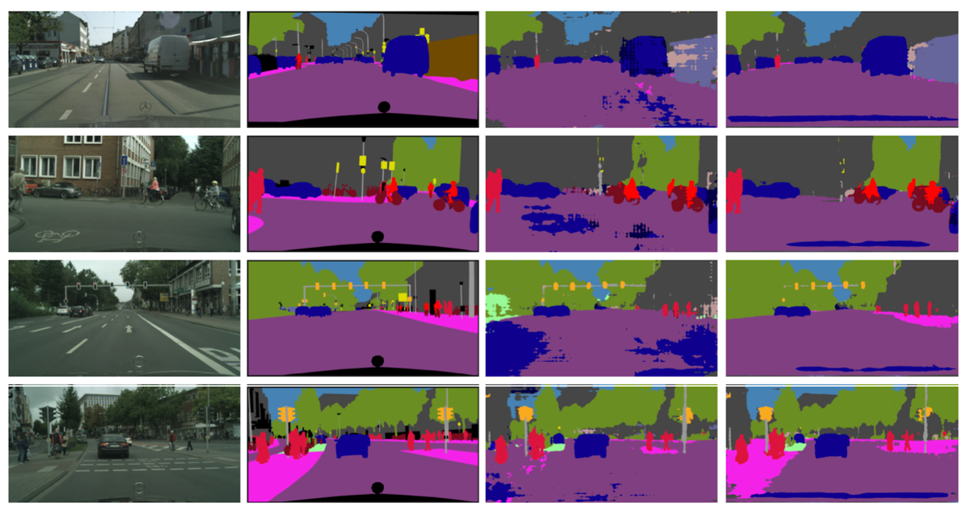
Challenges
- Target domain is unsupervised
- Domain gap between the source and target datasets
Target image
Ground truth
Before adaptation
After adaptation
[Tsai et al. In CVPR, 2018.]

Slide 4
Existing Strategies

Slide 5
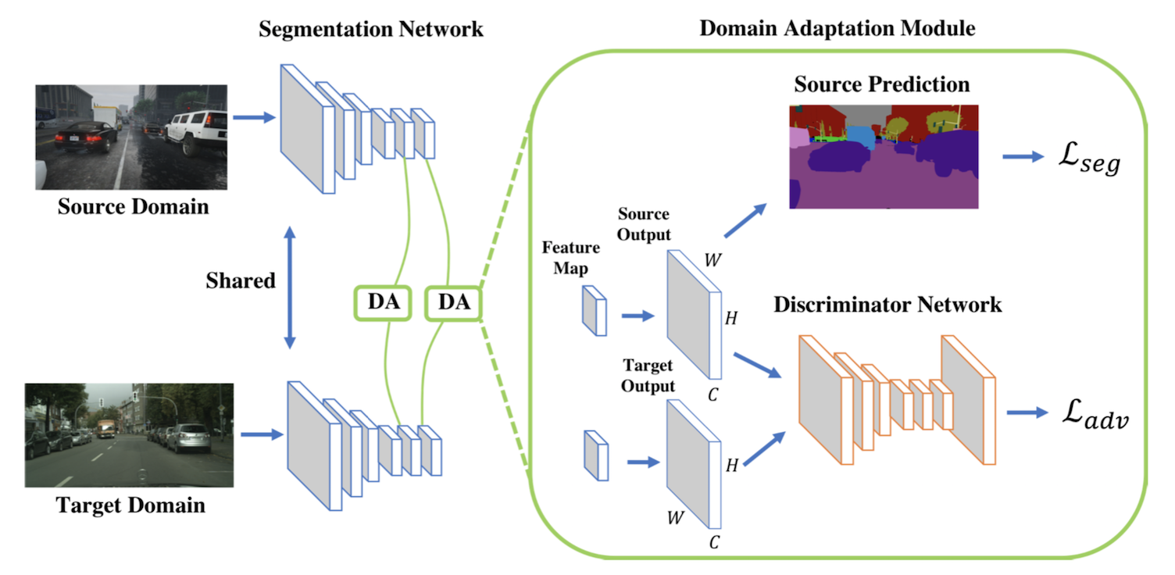
Feature-level Adaptation
Align the feature distributions between the source and target domains
[Tsai et al. In CVPR, 2018.]

Slide 6
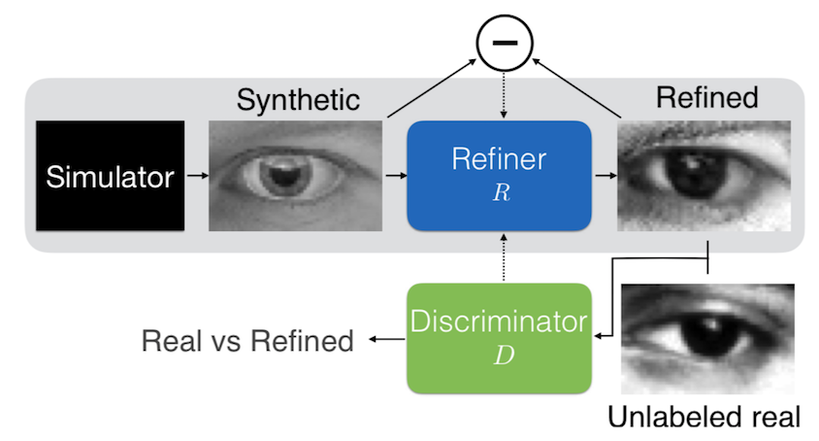
Pixel-level Adaptation
Perform data augmentation in the target domain
[Shrivastava et al. In CVPR, 2017.]

Slide 7
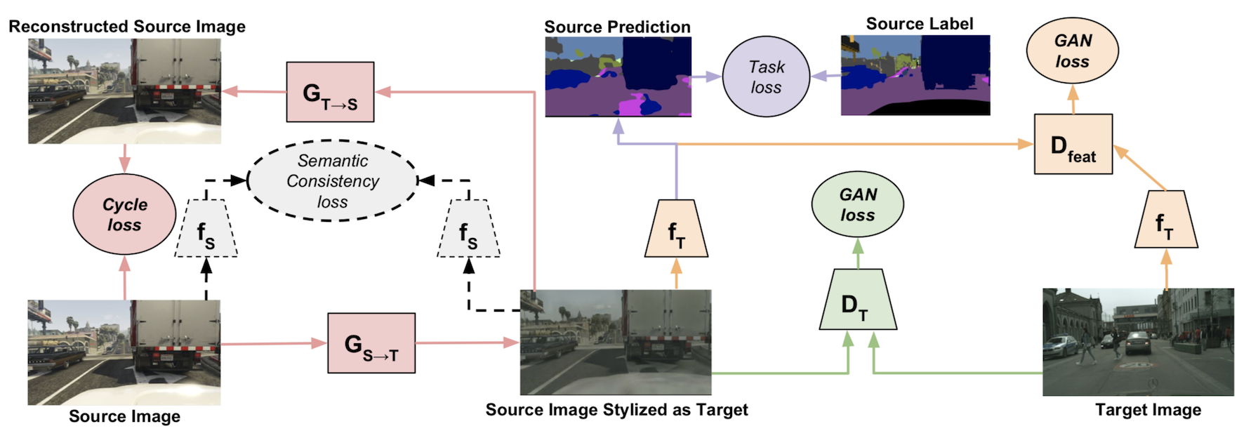
Joint Feature-level and Pixel-level Adaptation
[Hoffman et al. In ICML, 2018.]

Slide 8
Our Motivation

Slide 9
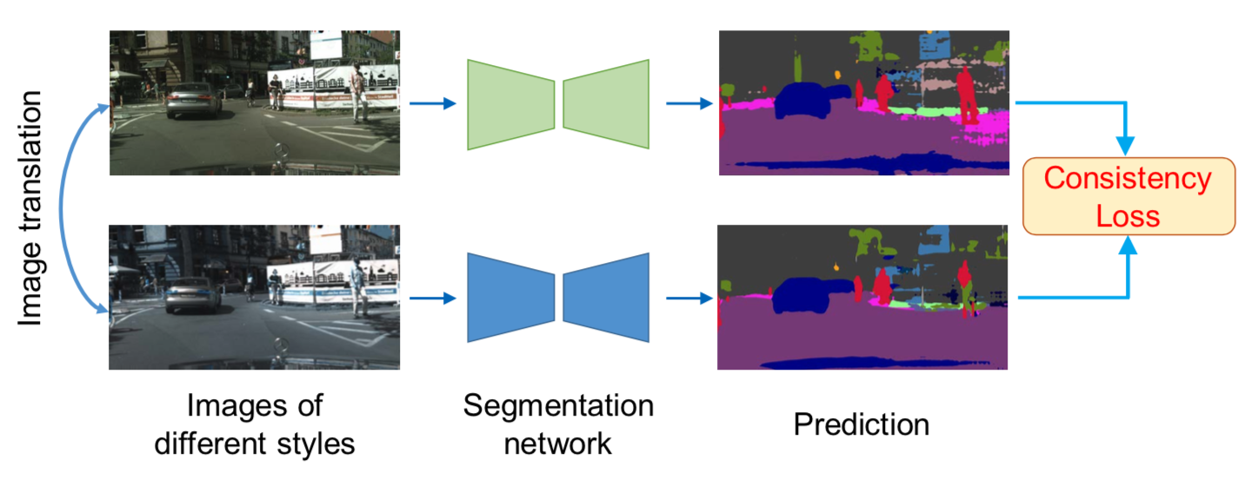
Main Idea
Images in different domains may have different styles
Task predictions should be exactly the same

Slide 10
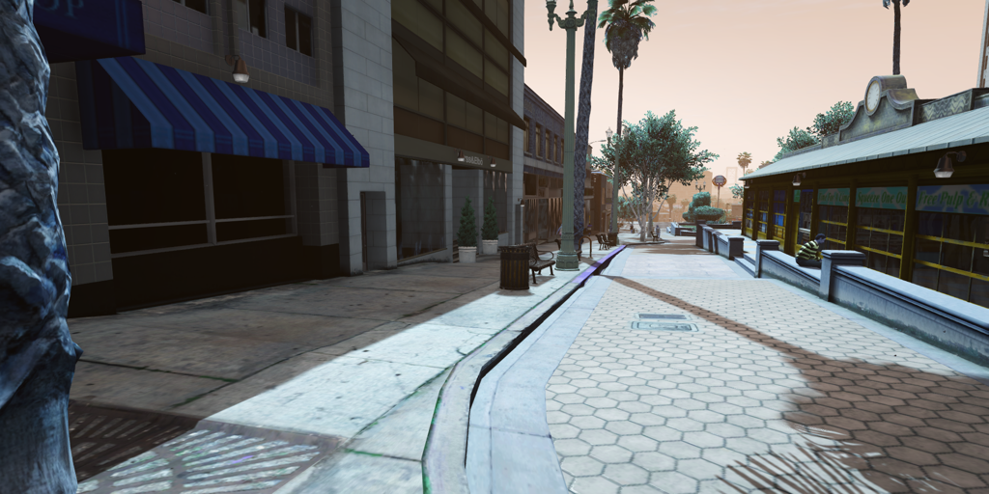
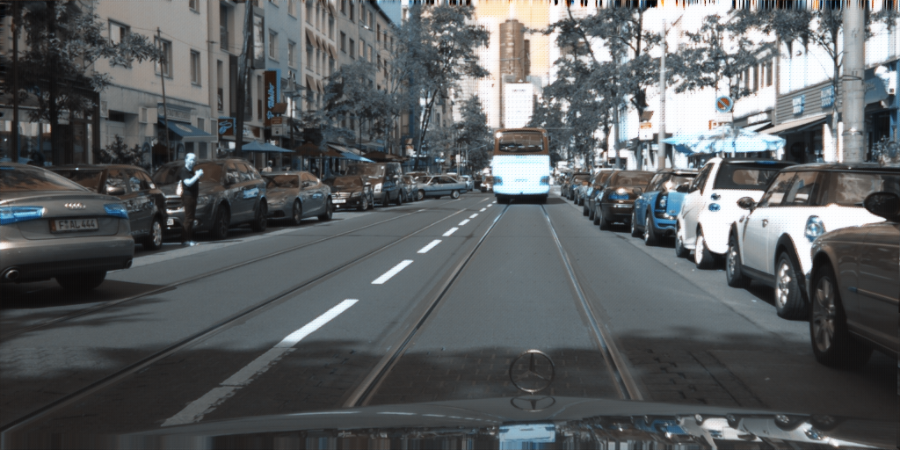
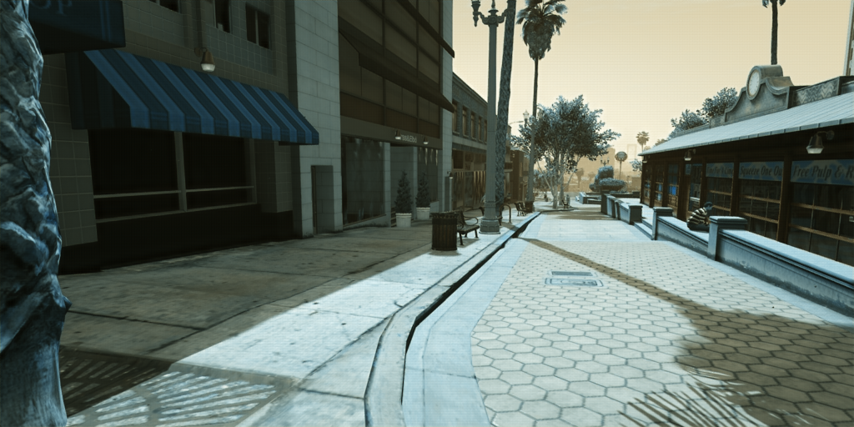
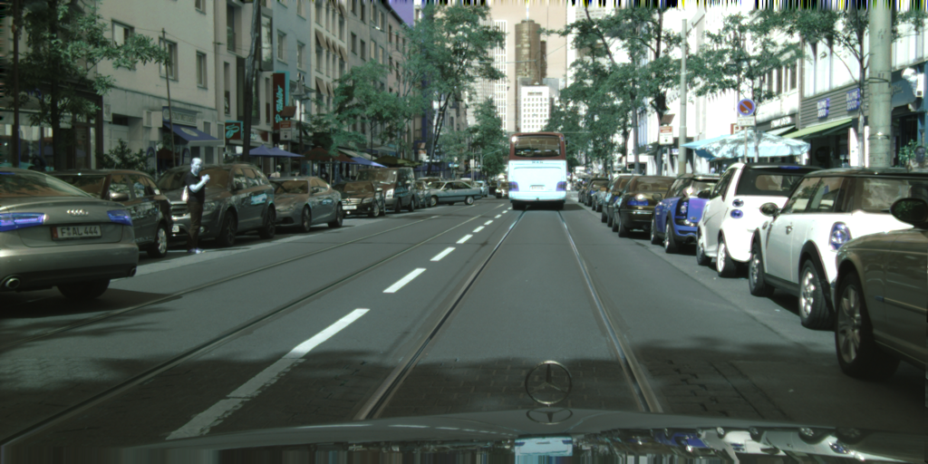
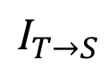
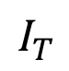
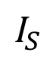
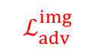
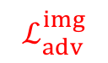
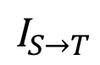
Proposed Method
Source
Domain
$${\text{I}}_{S}$$
$$ℒ_{adv}^{img}$$
G_{S->T}
$${\text{I}}_{T→S}$$
G_{T->S}
$${\text{I}}_{S→T}$$
$$ℒ_{adv}^{img}$$
Target
Domain
$${\text{I}}_{T}$$

Slide 11
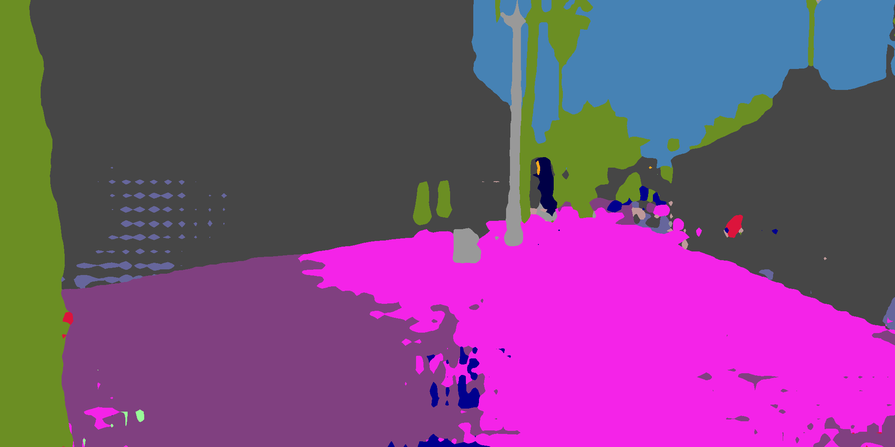
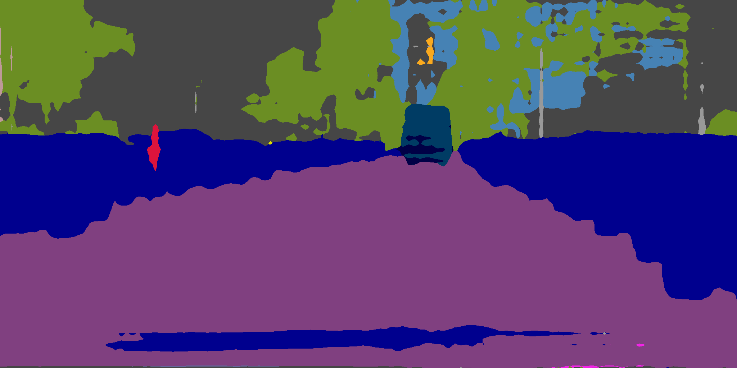
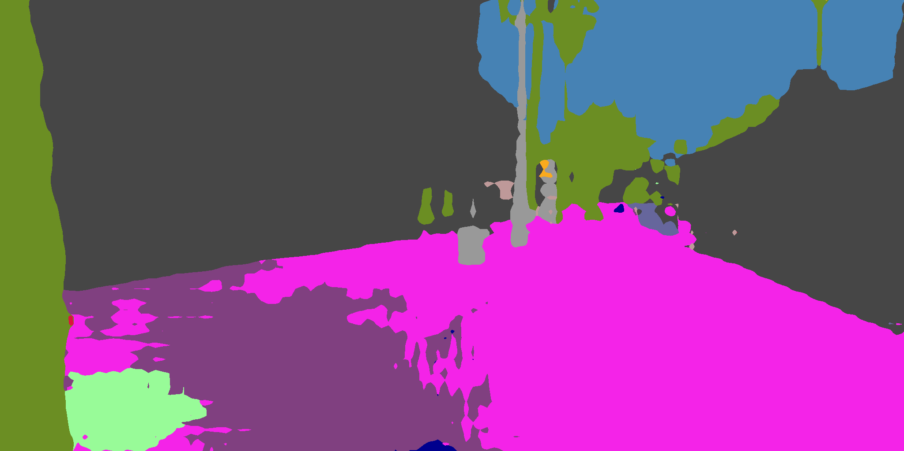
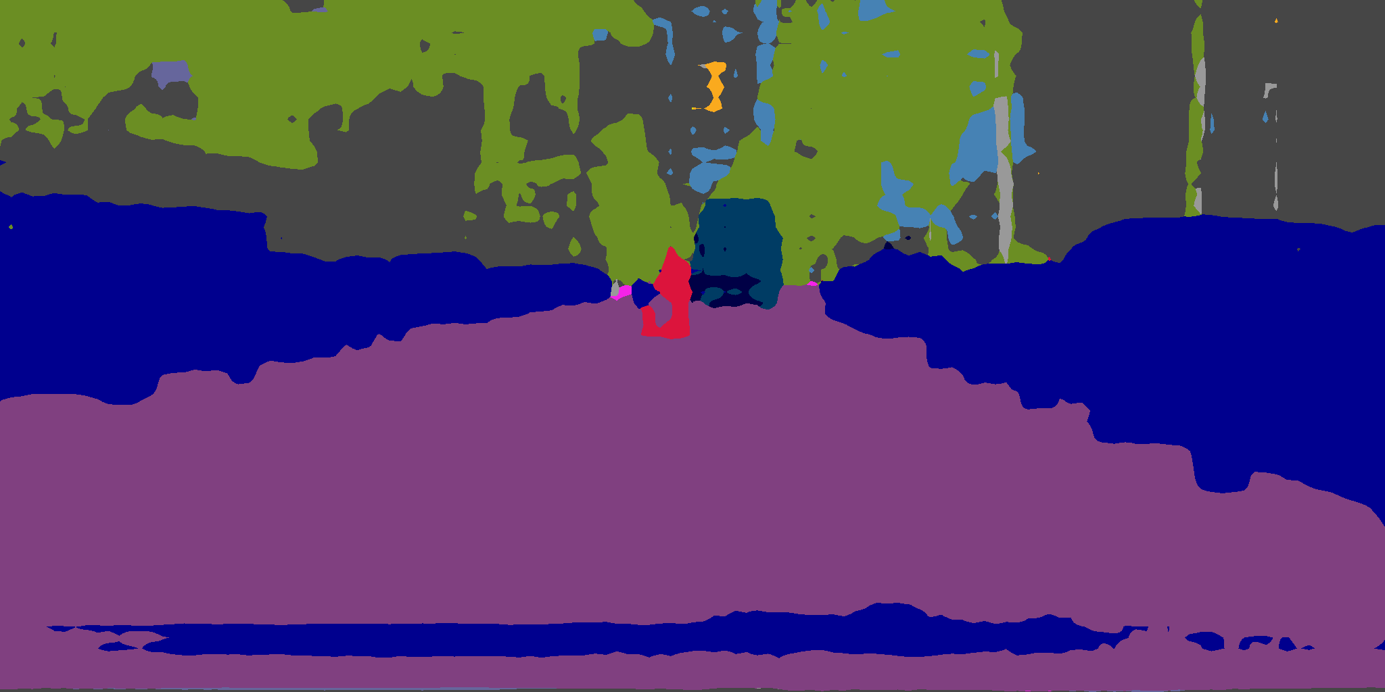
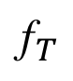
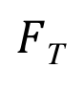
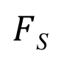


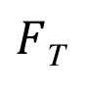
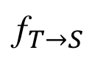
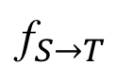
Proposed Method
Source
Domain
$F$_{S}
$${\text{I}}_{S}$$
f_{S}
$$ℒ_{adv}^{img}$$
$$ℒ_{adv}^{feat}$$
G_{S->T}
$F$_{S}
$${\text{I}}_{T→S}$$
$${\text{f}}_{T→S}$$
$F$_{T}
G_{T->S}
$${\text{I}}_{S→T}$$
$${\text{f}}_{S→T}$$
$$ℒ_{adv}^{img}$$
$$ℒ_{adv}^{feat}$$
Target
Domain
$F$_{T}
$${\text{I}}_{T}$$
$${\text{f}}_{T}$$

Slide 12
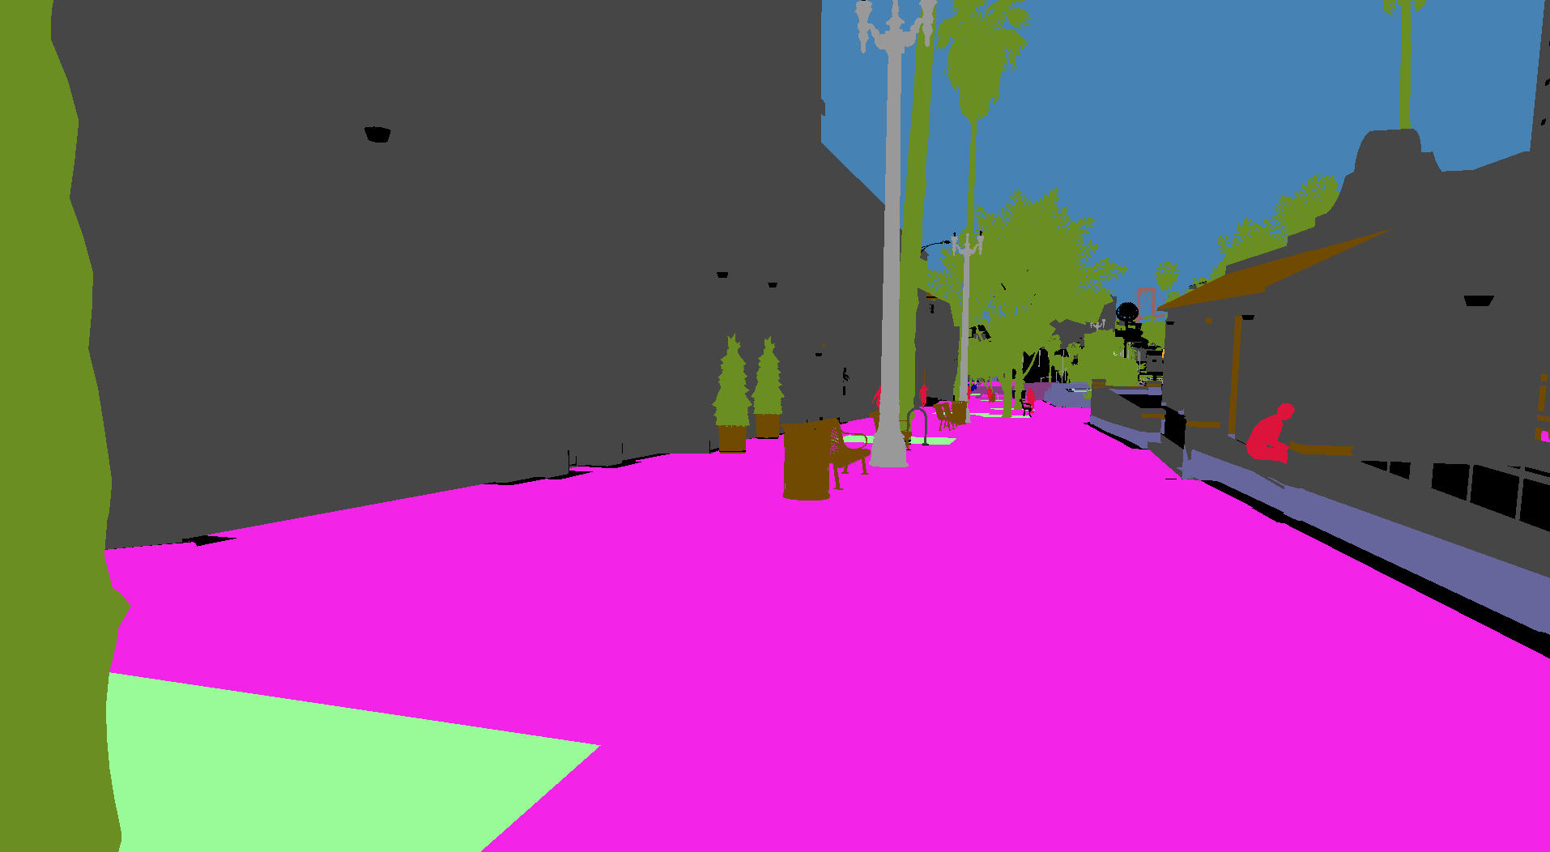
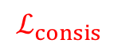


Proposed Method
Source
Domain
$F$_{S}
$$ℒ_{task}$$
$${\text{I}}_{S}$$
f_{S}
$$ℒ_{adv}^{img}$$
$$ℒ_{adv}^{feat}$$
G_{S->T}
Source label
$F$_{S}
$${\text{I}}_{T→S}$$
$${\text{f}}_{T→S}$$
$F$_{T}
$$ℒ_{task}$$
G_{T->S}
$${\text{I}}_{S→T}$$
$${\text{f}}_{S→T}$$
$$ℒ_{adv}^{img}$$
$$ℒ_{adv}^{feat}$$
$$ℒ_{consis}$$
Target
Domain
$F$_{T}
$${\text{I}}_{T}$$
$${\text{f}}_{T}$$

Slide 13
Proposed Method
Training
Testing

Slide 14
Evaluation

Slide 15
Experiment
Synthetic-to-real adaptation - Semantic segmentation - Single-view depth prediction - Optical flow estimation
Cross-city adaptation - Semantic segmentation

Slide 16
Synthetic-to-Real Adaptation
Semantic segmentation

Slide 17
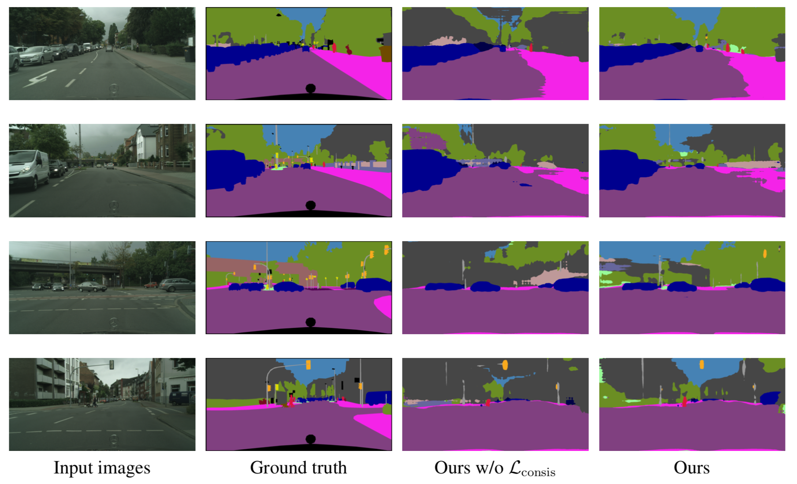
Visual Results
Input images
Ground truth
Ours w/o $ℒ_{consis}$
Ours

Slide 18
Synthetic-to-Real Adaptation
Single-view depth prediction

Slide 19
Visual Results
Input images
Ground truth
Ours w/o $ℒ_{consis}$
Ours

Slide 20
Synthetic-to-Real Adaptation
Optical flow estimation

Slide 21
Visual Results
Input images
Ground truth
Ours w/o $ℒ_{consis}$
Ours

Slide 22
Cross-City Adaptation

Slide 23
Conclusions
Cross-domain consistency
Application agnostic
State-of-the-art performances

Slide 24
Thanks for listening!

